Slide 1
Methods of changeover
Decide on the methods of changeover according to the four diagrams

Slide 2
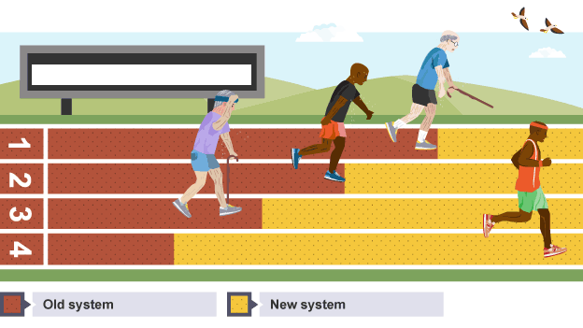
?

Slide 3
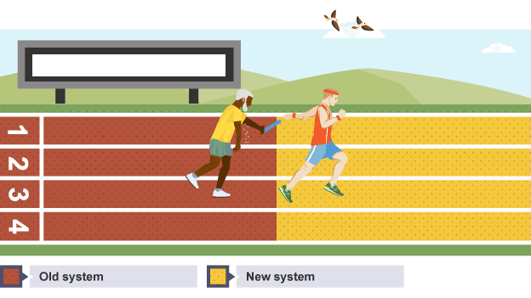
?

Slide 4
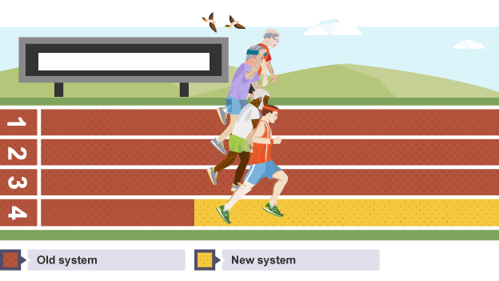
?

Slide 5



